Slide 1
RUNGTA COLLEGE OF DENTAL SCIENCES & RESEARCH
ERUPTION
DEPARTMENT OF ORAL PATHOLOGY

Slide 2
Specific learning Objectives
Core areas* | Domain ** | Category #
Definition of eruption | COGNITIVE | MUST KNOW
Pattern of tooth movement Histological changes Theories of eruption | COGNITIVE COGNITIVE COGNITIVE | MUST KNOW MUST KNOW MUST KNOW
Sequence of eruption Clinical implications Natal/Neonatal teeth | COGNITIVE COGNITIVE COGNITIVE | MUST KNOW NICE TO KNOW DESIRED TO KNOW

Slide 3
Contents
Definition of eruption
Pattern of tooth movement
Histological changes
Theories of eruption
Sequence of eruption
Clinical implications

Slide 4
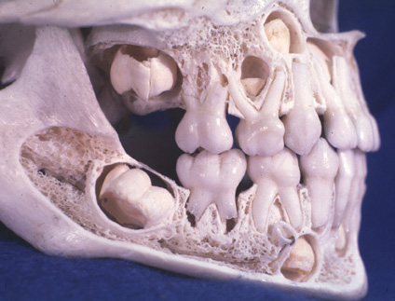
Physiologic Tooth Movement : ERUPTION
Eruption -
derived from Latin word meaning =
“ to break out ”

Slide 5
Definition:
The axial or occlusal movement of tooth from its developmental position within the jaw to its functional position in the occlusal plane.

Slide 6
Functional position
(occlusal plane)
Axial movement
Developmental position
(occlusal plane)

Slide 7
Pattern of tooth movement
Preeruptive movement
Eruptive movement
Posteruptive movement

Slide 8
Two types of tooth movement in pre-eruptive phase :
Helps in placing the teeth in a location within the jaw that enables eruption to occur
Total bodily movement
Eccentric Movement : where one part remains fixed while the rest continues to grow leading to change in the center of the tooth germ.
Incisors placed lingually
By bodily movement

Slide 9
Incisors & canines (Permanent) = develop on lingual aspect of deciduous predecessors.
Premolars (Permanent) = below the divergent roots of deciduous molars
Molars = develop by distal extension of dental lamina

Slide 10
lingual aspect
below the divergent roots of deciduous molars
distal extension of dental lamina

Slide 12
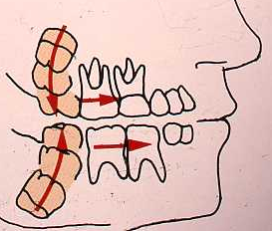
Eruptive Tooth Movement
3 major events occur:
Root formation.
Movement. (Occurs occlusally)
3. Movement continues until clinical contact with the opposing crown occurs.

Slide 13
Post Eruptive Tooth Movement
Movements to accommodate the growing jaws.
Movements to compensate for continued occlusal wear.
(Compensation occurs by continuous deposition of
cementum around the apex of the tooth)
Movements to accommodate interproximal wear. Compensated by mesial /proximal drift.

Slide 14
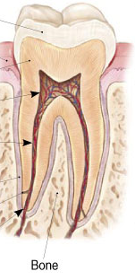
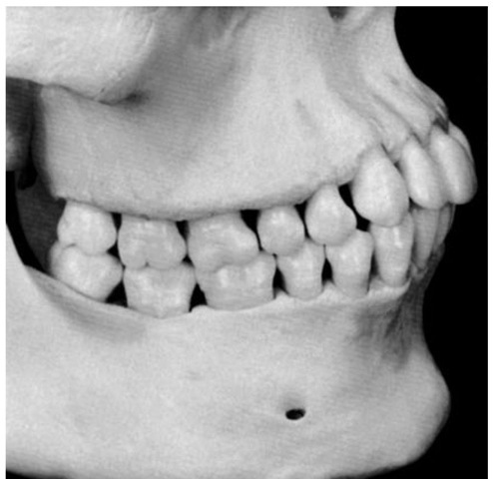
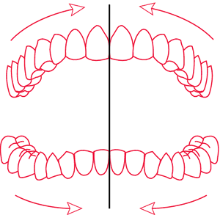
Compensated by
Occlusal wear.
continuous deposition of cementum around the apex of the tooth
Interproximal wear
mesial /proximal drift
( lateral bodily movement of teeth on both side )

Slide 15
Histologic changes
1) Remodelling of PDL fibres
2) Degeneration & synthesis of collagen fibres by fibroblasts
3) Gubernacular canal & cord

Slide 16
Gubernacular canal & cord
Gubernacular cord:
The connective tissue overlying a successional tooth that connects with the lamina propria of the oral mucosa by means of a strand of fibrous connective tissue.

Slide 17
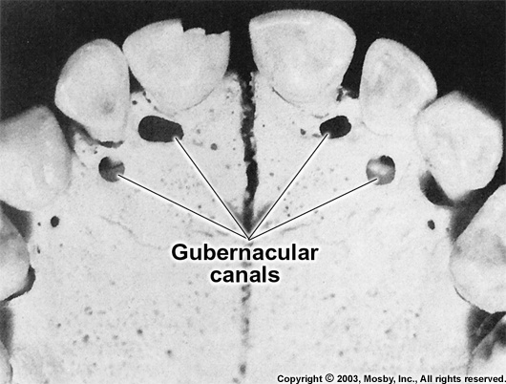
As the successional teeth erupt, gubernacular canal widens enabling tooth to erupt .
Significance :- Provides a path of least resistance & is actively engaged in pulling the tooth out from the underlying tissues.

Slide 18
Theories of tooth eruption
The accepted theories of tooth eruption are:
Root formation theory
Vascular (Hydrostatic) pressure theory
Bone remodelling theory
Periodontal ligament traction theory

Slide 19
Root Formation theory
The apical growth of roots results in an occlusally directed force that brings about the eruption of teeth.
The resistance by cushion hammock ligament at the socket base results in the occlusal movement of the tooth crown as the root lengthens.
Cushion hammock ligament

Slide 20
Bone Remodeling Theory
Complex process that involves bone resorption (performed by osteoclasts) followed by bone formation (by osteoblasts)
Bone resorption
+
Bone deposition
Bone Remodelling

Slide 21
Bone Remodeling Theory
Selective bone deposition and bone resorption in the area around the tooth is believed to cause axial movement of tooth.
Bone resorption – above tooth apex
Bone deposition – below tooth base

Slide 22
Hydrostatic (VASCULAR) Pressure theory
According to this theory –
1) A high pressure system around base of tooth
2) Alteration in local vascular supply
3) Local retention of water in PDL
Axial ( occlusal ) movement of tooth

Slide 23
Periodontal ligament traction theory
Periodontal ligament - Formation and renewal of PDL can be a factor in tooth eruption because of the traction power of the fibroblasts.
The contractility of fibroblasts is responsible for the force required for tooth eruption

Slide 24
Fibroblast (Initial contractile force)
Force transmitted to fibronexus
Fibronexus transmits force to collagen fibre bundles (alingned in oblique fashion)

Slide 25
FIBRONEXUS

Slide 26
Eruption Rates
Eruption rates will differ based on tooth type – balance between eruptive forces and resistive forces
For eg :-
permanent maxillary incisors – 1mm / month
mandibular second molars – 4.5 mm in 14 weeks
permanent third molars – 1 mm in 3 months
eruption rates can slow to 1 mm /6 months in crowded dentitions

Slide 27
Eruption time of Primary Dentition
Tooth | Eruption age (in months) | SEQUENCE OF ERUPTION
Maxillary Teeth
CI | 7.5 | Man CI
LI | 9 | Man LI
Canine | 18 | Max CI
1st M | 14 | Max LI
2nd M | 24 | Man 1st M
Mandibular Teeth |  | Max 1st M
CI | 6 | Man C
LI | 7 | Max C
Canine | 16 | Man 2nd M
1st M | 12 | Max 2nd M
2nd M | 20

Slide 28
Sequence of eruption
Primary
A B D C E
A B D C E

Slide 29
Tooth | Eruption age (in Years) | SEQUENCE OF ERUPTION
Maxillary Teeth
CI | 7-8 | Man 1st M
LI | 8-9 | Max 1st M
Canine | 11-12 | Man CI
1st PM | 10-11 | Max CI
2nd PM | 10-12 | Man LI
1st M | 6-7 | Max LI
2nd M | 12-13 | Man C
Mandibular Teeth |  | Max 1st PM
CI | 6-7 | Man 1st PM
LI | 7-8 | Max 2nd PM
Canine | 9-10 | Man 2nd PM
1st PM | 10-12 | Max C
2nd PM | 11-12 | Man 2nd M
1st M | 6-7 | Max 2nd M
2nd M | 11-13

Slide 30
Sequence of eruption
6 1 2 4 5 3 7 8
61 2 3 4 5 7 8
Permanent

Slide 31
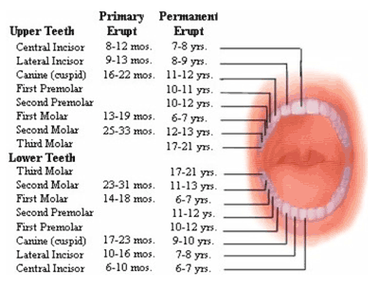

Slide 32
Natal & Neonatal teeth
Also called Foetal / Congenital teeth
Natal teeth are teeth that are present at birth.
Neonatal teeth are teeth that emerge through the gingiva during the first month of life.
The incidence of neonatal teeth varies considerably, between 1:700 - 1:30,000

Slide 33
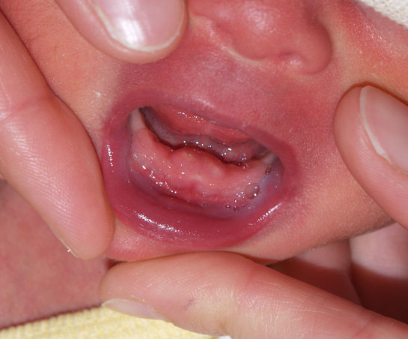
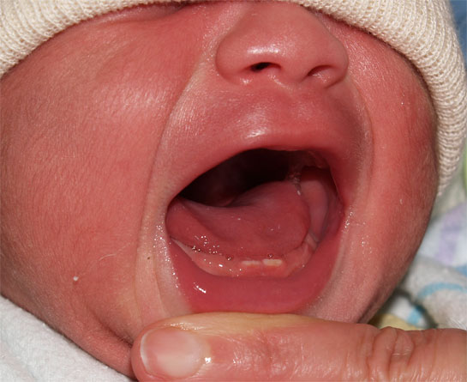
85% are the deciduous mandibular incisors
Natal > Neonatal teeth ( 3:1 )
Females > males

Slide 34
Summary/take home message
Tooth eruption is a process in tooth development in which the teeth enter the mouth and become visible. It is currently believed that the periodontal ligament plays an important role in tooth eruption. Although tooth eruption occurs at different times for different people, a general eruption timeline exists.
Although researchers agree that tooth eruption is a complex process, there is little agreement on the identity of the mechanism that controls eruption. There have been many theories over time. Inherent in most of the theories outlined above is the idea that a force is generated in the periodontal ligament beneath unerupted teeth, and that this force physically drives teeth out through the bone. This idea may have been superseded by a further recent theory.

Slide 35
References
SN Bhaskar . Orban’s ,Oral Histology and embryology. 11th edition, Mosby 1998
Neville BW ,Damm DD ,Allen CM ,Bouquot JE . Oral and maxillofacial pathology , 2nd Edition .Philadelphia W.B. Saunders ;2002
Richard Tencate , Oral Histology development ,structure and function . 5th Edition ,1998
Carranza F.A., Michael G. Newman . Clinical periodontology 8,9,10th edition

Slide 36
FAQs
Define eruption. Mention about various theories of eruption. Write in detail about PDL traction theory
Phases & sequence of eruption / chronology
Gubernacular canal & cord
Natal & neonatal teeth
Odontoclast
Submerged & impacted tooth

Slide 37
THANKYOU

